Slide 1
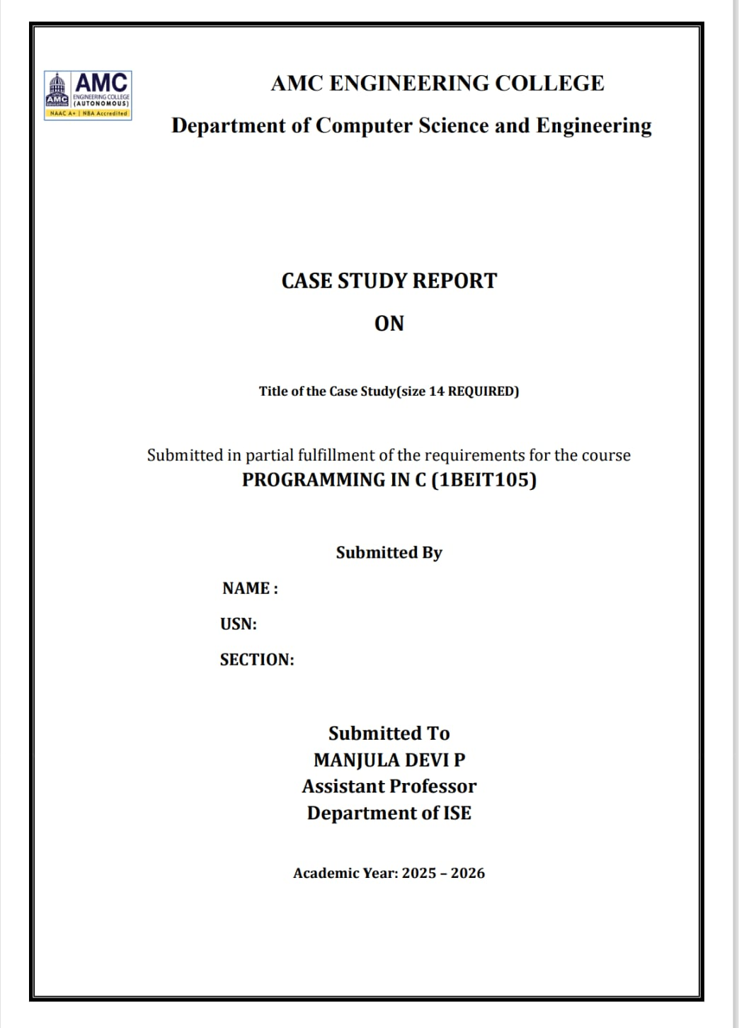
Daily-life numeric case studies Electricity/Water Bill Calculator
SAMMED MAHAVEER
CSE SEC-D

Slide 2
1. INTRODUCTION
1.1 Background
Electricity and water are essential daily utilities.
Monthly bills are calculated based on consumption.
Utility boards follow slab-wise tariff systems.
Manual calculation is time-consuming and error-prone.
Programming helps automate bill calculation accurately.
2. Problem Statement
To design and implement a C program that accepts student details such as name, roll number, and marks in 3–5 subjects, and displays total marks, average marks, and result status.

Slide 3
3. Existing System
3.1 Description
The existing system involves manual entry of marks and calculations using registers or calculators.
3.2 Drawbacks
Time-consuming
Error-prone
Difficult to handle multiple students
3. Existing System
3.1 Description
The existing system involves manual entry of marks and calculations using registers or calculators.
3.2 Drawbacks
Time-consuming
Error-prone
Difficult to handle multiple students
4. Proposed System
4.1 Description
The proposed system uses C programming concepts to automate student result processing.
4.2 Advantages
Faster computation
Accurate results
Easy maintenance
Reduced manual work

Slide 4
3. Existing System
3.1 Description
The existing system involves manual entry of marks and calculations using registers or calculators.
3.2 Drawbacks
Time-consuming
Error-prone
Difficult to handle multiple students
5. Requirements
5.1 Hardware Requirements
Computer system
5.2 Software Requirements
Operating system
C compiler (GCC / Turbo C)
6. System Design
6.1 Concepts Used
printf and scanf
Arithmetic operations
Arrays
if–else
Structures

Slide 5
3. Existing System
3.1 Description
The existing system involves manual entry of marks and calculations using registers or calculators.
3.2 Drawbacks
Time-consuming
Error-prone7. Implementation
7.1 Algorithm
Start
Read number of students
Read student name and roll number
Read marks of 3–5 subjects
Calculate total and average
Check pass or fail
Display result
Stop
Difficult to handle multiple students
7. Implementation
7.1 Algorithm
Start
Read number of students
Read student name and roll number
Read marks of 3–5 subjects
Calculate total and average
Check pass or fail
Display result
Stop

Slide 6
3. Existing System
3.1 Description
The existing system involves manual entry of marks and calculations using registers or calculators.
3.2 Drawbacks
Time-consuming
Error-prone7. Implementation
7.1 Algorithm
Start
Read number of students
Read student name and roll number
Read marks of 3–5 subjects
Calculate total and average
Check pass or fail
Display result
Stop
Difficult to handle multiple students
7.2 Program Code
#include <stdio.h>
struct student {
int roll;
char name[20];
int marks[5];
int total;
float average;
};
int main() {
struct student s[10];
int i, j, n, subjects;
printf("Enter number of students: ");
scanf("%d", &n);
printf("Enter number of subjects (3 to 5): ");
scanf("%d", &subjects);
for(i = 0; i < n; i++) {
s[i].total = 0;
printf("\nEnter Roll Number: ");
scanf("%d", &s[i].roll);
printf("Enter Name: ");
scanf("%s", s[i].name);

Slide 7
3. Existing System
3.1 Description
The existing system involves manual entry of marks and calculations using registers or calculators.
3.2 Drawbacks
Time-consuming
Error-prone7. Implementation
7.1 Algorithm
Start
Read number of students
Read student name and roll number
Read marks of 3–5 subjects
Calculate total and average
Check pass or fail
Display result
Stop
Difficult to handle multiple students
printf("Enter marks:\n");
for(j = 0; j < subjects; j++) {
scanf("%d", &s[i].marks[j]);
s[i].total += s[i].marks[j];
}
s[i].average = s[i].total / (float)subjects;
}
printf("\n----- STUDENT RESULT -----\n");
for(i = 0; i < n; i++) {
printf("\nRoll No: %d", s[i].roll);
printf("\nName: %s", s[i].name);
printf("\nTotal Marks: %d", s[i].total);
printf("\nAverage Marks: %.2f", s[i].average);
if(s[i].average >= 40)
printf("\nResult: PASS\n");
else
printf("\nResult: FAIL\n");
}
return 0;
}

Slide 8
3. Existing System
3.1 Description
The existing system involves manual entry of marks and calculations using registers or calculators.
3.2 Drawbacks
Time-consuming
Error-prone7. Implementation
7.1 Algorithm
Start
Read number of students
Read student name and roll number
Read marks of 3–5 subjects
Calculate total and average
Check pass or fail
Display result
Stop
Difficult to handle multiple students
7.3 Conclusion
This case study successfully implements a Student Marks and Result System using C programming. The program accurately calculates total marks, average marks, and determines pass or fail status.
The system reflects real-world academic requirements and reduces manual effort while improving reliability.
7.4 Limitations and Future Enhancements
Limitations
Fixed number of students
No permanent data storage
No grade calculation
Future Enhancements
File handling for data storage
Grade system implementation
Search by roll number
Dynamic memory allocation

Slide 9
8. Reflection (Experiential Learning Component)
This project involved applying C concepts such as arrays, structures, loops, and conditional statements. Debugging logical errors helped improve problem-solving skills. The project enhanced understanding of real-world program design and implementation.
8. Reflection (Experiential Learning Component)
This project involved applying C concepts such as arrays, structures, loops, and conditional statements. Debugging logical errors helped improve problem-solving skills. The project enhanced understanding of real-world program design and implementation.
9. Appendix
9.1 Source Code
Complete C program with proper formatting
9.2 Output
Program execution screenshots
9.3 References
C Programming Textbook
Lab Manual
Online C Documentation

